Slide 1


<Walter Medina>
<16/12/2024>

Slide 2

Outline
Executive Summary
Introduction
Methodology
Results
Conclusion
Appendix

Slide 3
Executive Summary
Summary of methodologies
The present research attempts to identify the important factors for a successful landing, to approach this, the following methodologies where used:
Collect
Explores and Analyze
Build Model
Results
The model that performed better is the Decision tree model with 83% of accuracy for a successful landing

Slide 4
Introduction
Project background and context
SpaceX, a one of the leaders in the space industry want to make space travel affordable for everyone and for research missions. SpaceX search for save a money because these attempts of landing are expensive. To reduce it we can predict if the landing are successful or not.
Problems you want to find answers
Factors can be affecting the successful landing.
Best predictive model

Slide 5

Section 1

Slide 6
Methodology
Executive Summary
Data collection methodology:
Data of SpaceX Rest API (Web Scraping)
Perform data wrangling
Filtering data, handling missing values and applying one hot encoding
Perform exploratory data analysis (EDA) using visualization and SQL
Perform interactive visual analytics using Folium and Plotly Dash
Perform predictive analysis using classification models
Tests with 5 models and use tuning for search the best parameters.

Slide 7
Data Collection – SpaceX API
Request data from Space X website
Decode Response using .json to normalize
Request information related to the information
Create Dictionary
Create Dataframe
Filter Dataframe with the Falcon 9 launches
Handling Missing Values
Export and save data

Slide 8
Data Collection - Scraping
Request data from Wikipidedia Website
Using Beautiful Soup Library
Extract columns with some labels
Collect data
Create diccionary
Create dataframe
Save and export data

Slide 9
Data Wrangling
Perform EDA
Calculations
# of launches, occurrence for orbit/ site/mission
Creation of dependent variable
Landing Outcome
If landing was successful.

Slide 10
EDA with Data Visualization
Charts
Flights Number vs Payload
Flights Number vs Launch Site
Payload Mass(Kg) vs Launch Site
Payload Mass(Kg) vs Orbit type
Analysis
Correlation different variables.
Some comparisons among categories showing the relationship.

Slide 11
EDA with SQL
Some queries like:
Distinct launch sites
Total payload mass carried by boosters
Some Average
Dates of successful landing
Names of boosters with some conditions
Total of failed missions

Slide 12
Build an Interactive Map with Folium
- Markers indicating Launch Sites with up pop up label
Colored markers
Successful: Green
Unsuccessful: Red
Distance of proximity
To coastline
Railway
Highway

Slide 13
Build a Dashboard with Plotly Dash
Dropdown List with Launch Sites
Pie Chart showing Successful Launches
Slider of Payload Mass Range
Scatter Chart (Payload Mass vs Booster Version )

Slide 14
Predictive Analysis (Classification)
Standardize the data
Split in train , test dataframe
Using GridSearchCV
Apply in different algorithms:
Logistic Regression
Support Vector Machine
Decision Tree Classifier
KNN
Performance of models

Slide 15
Results
Exploratory data analysis results
Launch success has improved over time
Some orbits have a high success rate.
Interactive analytics
Some launch depends of the location and how near are at the coast.
Predictive analysis results
Decision tree model is the best predictive model

Slide 16

Section 2

Slide 17
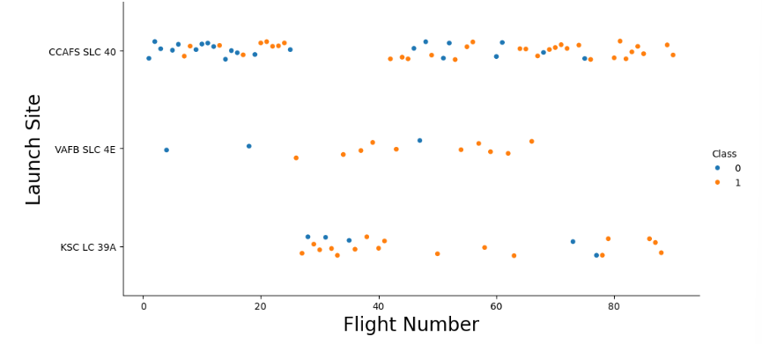
Flight Number vs. Launch Site
Later flights had a success rate
We can consider that new launches have a higher success rate.

Slide 18
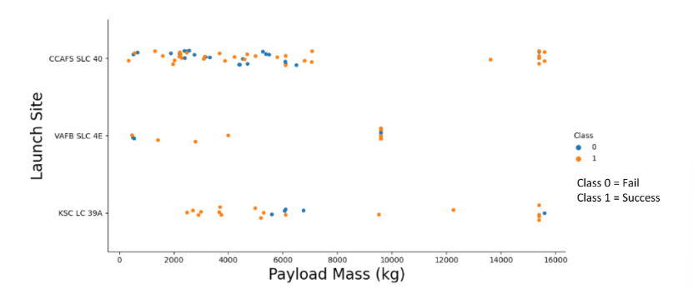
Payload vs. Launch Site
Most Launches with a payload greater than 7000 Kg were successful.
We can consider the higher the payload mass then higher the success rate.

Slide 19
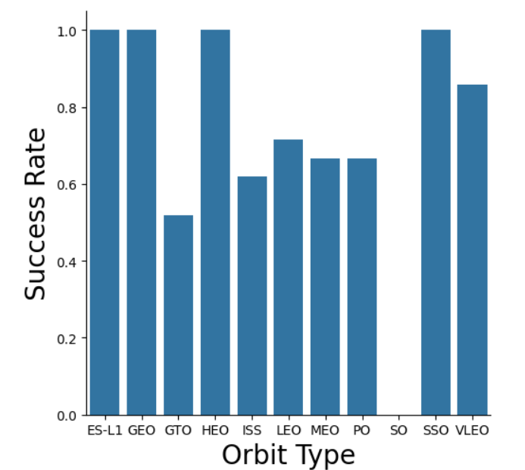
Success Rate vs. Orbit Type
100% Success rate: ES- L1, GEO, HEO and SSO
0% Success rate: SO

Slide 20
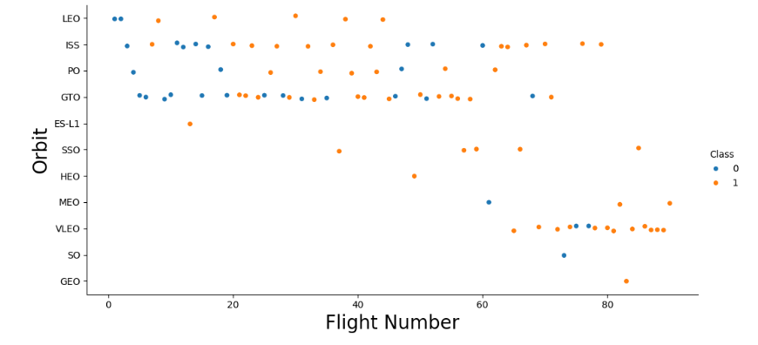
Flight Number vs. Orbit Type
In Leo orbit the relationship is highly apparent
Success rate increases with the number of flights

Slide 21
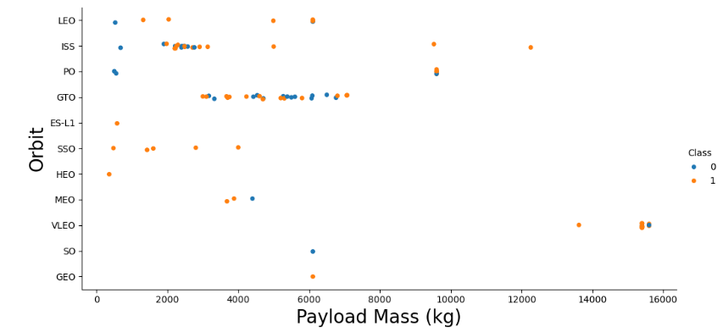
Payload vs. Orbit Type
With heavy payloads the successful landing or positive landing rate are more for Polar,LEO and ISS.
For GTO, it's difficult to distinguish between successful and unsuccessful landings as both outcomes are present.

Slide 22
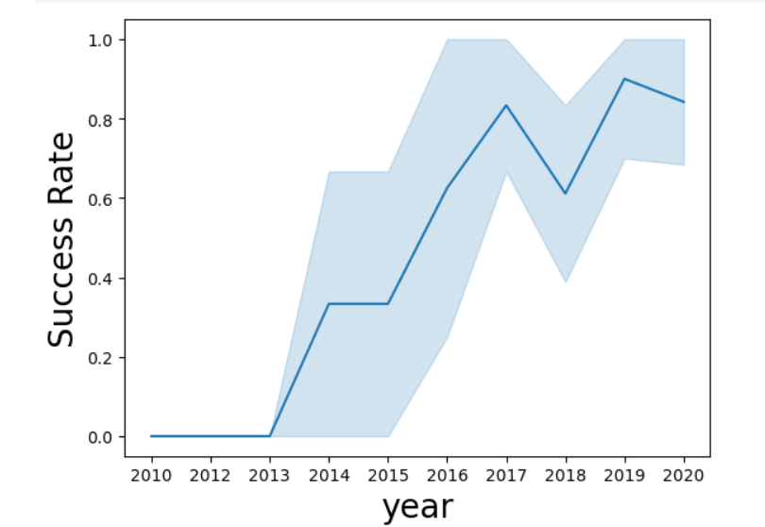
Launch Success Yearly Trend
We can observe that the success rate since 2013 kept increasing till 2020

Slide 23
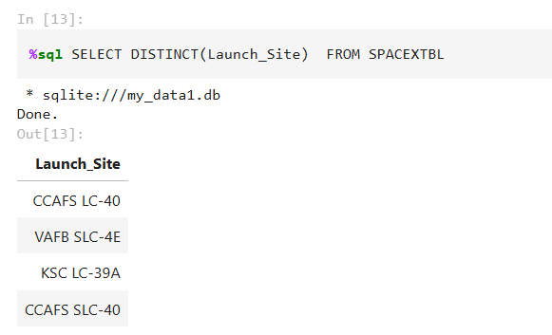
All Launch Site Names
Distinct Launch Sites:

Slide 24
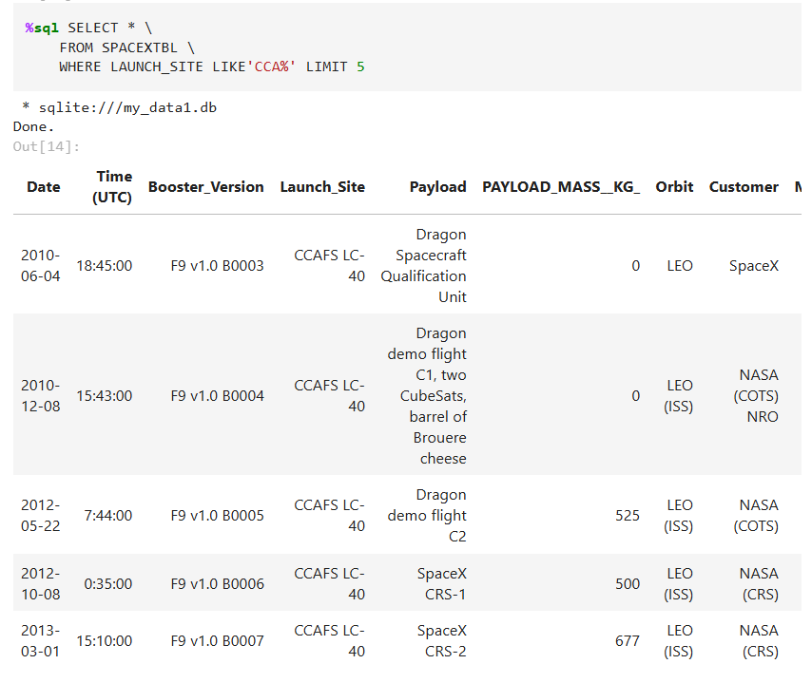
Launch Site Names Begin with 'CCA'
5 records where launch sites begin with CCA:

Slide 25
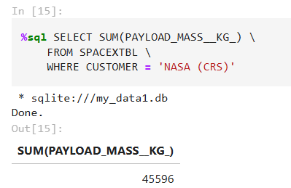
Total Payload Mass
The total payload carried by boosters from NASA:

Slide 26
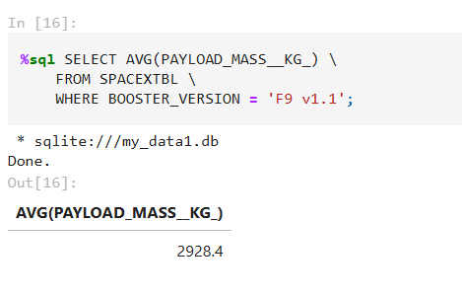
Average Payload Mass by F9 v1.1
The average payload mass carried by booster version F9 v1.1

Slide 27
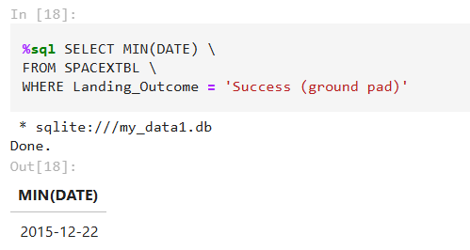
First Successful Ground Landing Date
Firs Susccesful using min function:

Slide 28
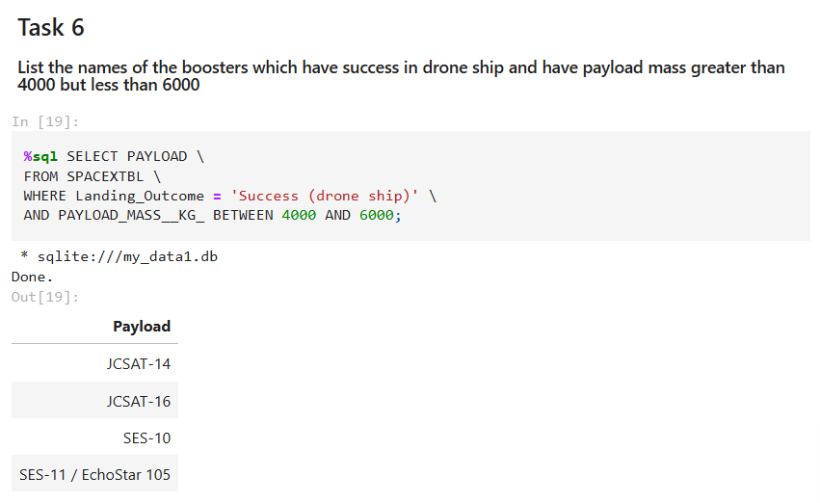
Successful Drone Ship Landing with Payload between 4000 and 6000
Names of boosters which have successfully landed on drone ship and had payload mass greater than 4000 but less than 6000

Slide 29
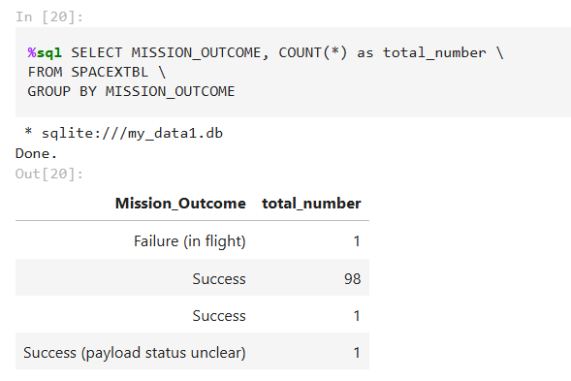
Total Number of Successful and Failure Mission Outcomes
Total number of successful and failure mission outcomes

Slide 30
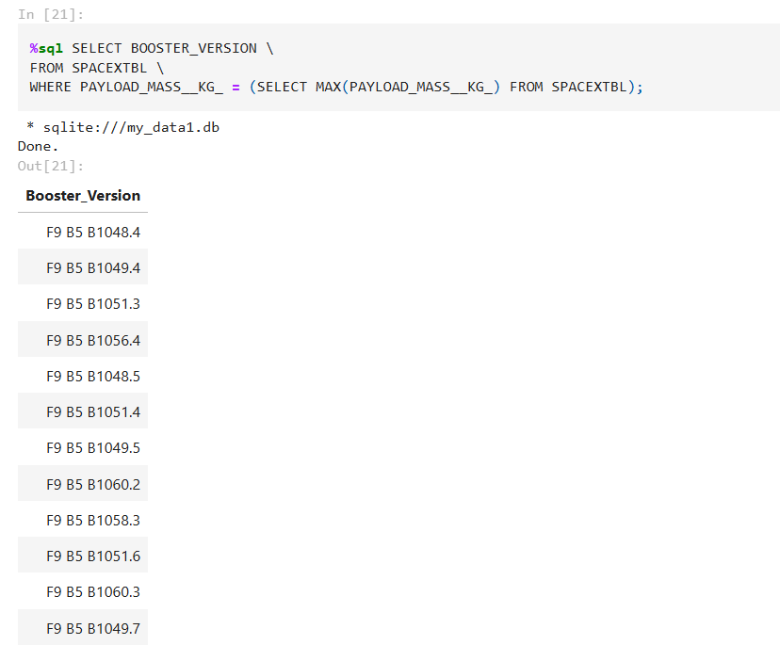
Boosters Carried Maximum Payload
The names of the booster which have carried the maximum payload mass

Slide 31
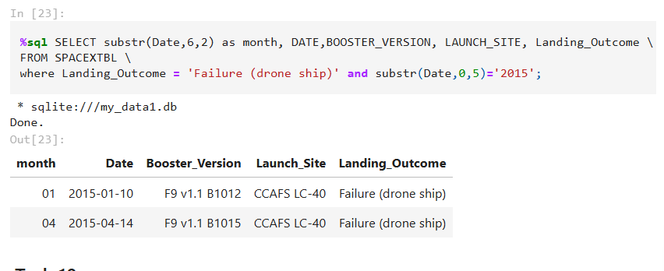
2015 Launch Records
Failed landing_outcomes in drone ship, their booster versions, and launch site names for in year 2015

Slide 32
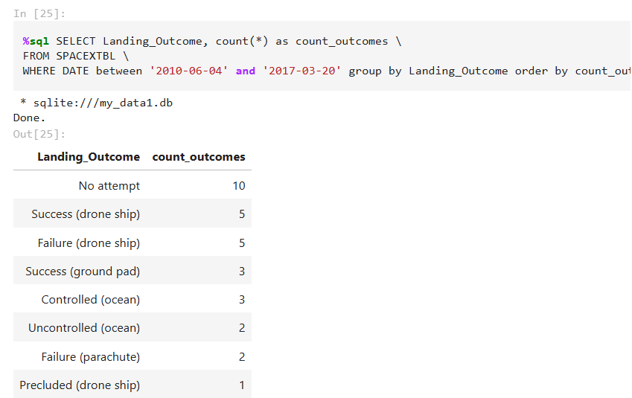
Rank Landing Outcomes Between 2010-06-04 and 2017-03-20
Rank of the count of landing outcomes (such as Failure (drone ship) or Success (ground pad)) between the date 2010-06-04 and 2017-03-20

Slide 33

Section 3

Slide 34
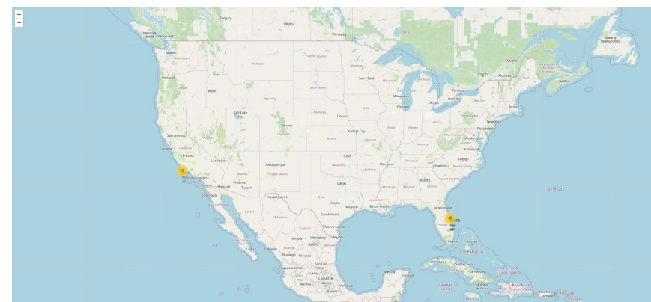
Launch Sites
With Markets, we can indicate the location of launch sites(successful or unsuccesful)

Slide 35
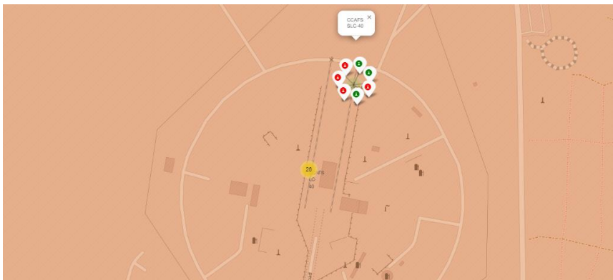
<Launch Outcomes>
Green markers for successful launches.
Red markers for unsuccessful launches.

Slide 36
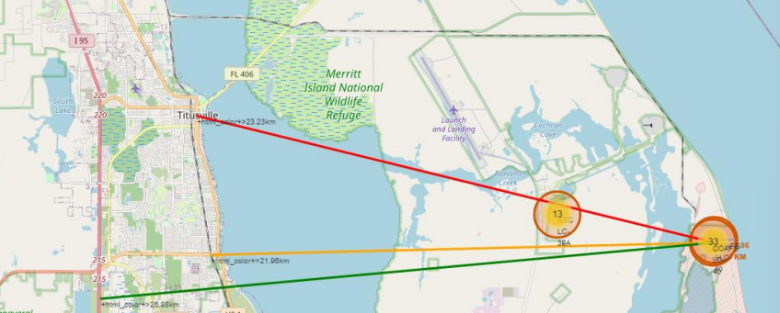
Proximity
We can draw lines of distance to coastline , railway, highway.

Slide 37

Section 4

Slide 38
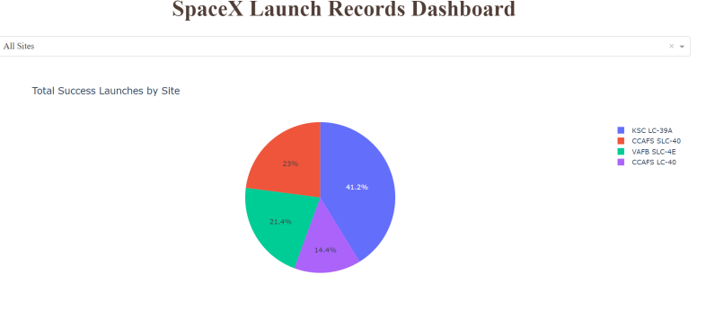
Launches Success by Site
Success as percent
We can see the most successful launches and the most unsuccessful.

Slide 39
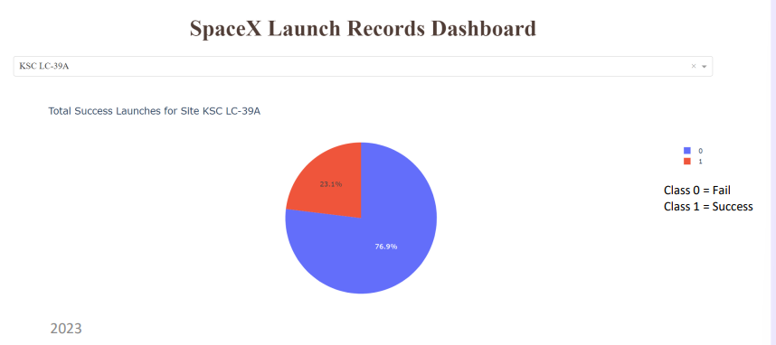
Launch Success(LC 29 A)
It has a 76.9% of success rate.

Slide 40
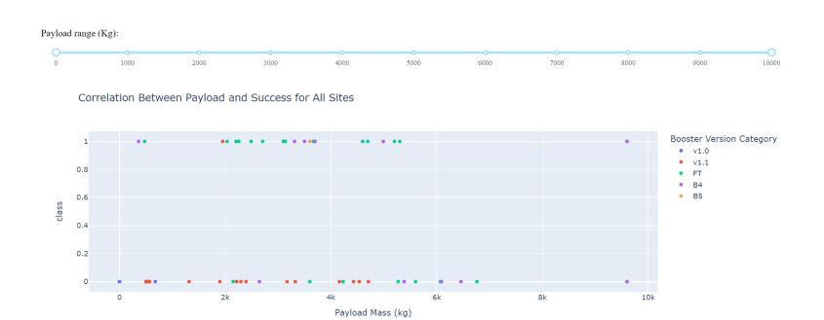
Payload Mass and Success
We can see relationship by Payload and Success:

Slide 41

Section 5

Slide 42
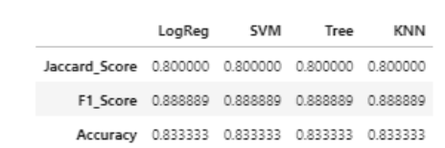
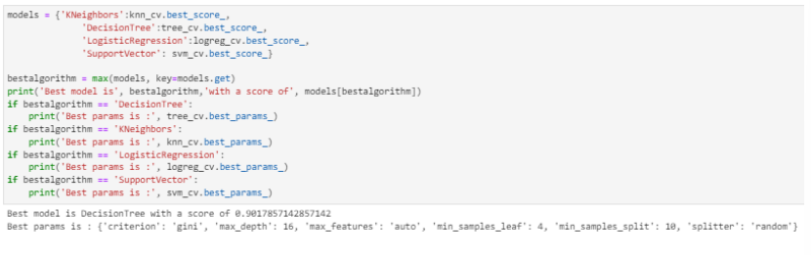
Classification Accuracy
The best model is Decision Tree model because the best_score is a mean of parameters

Slide 43
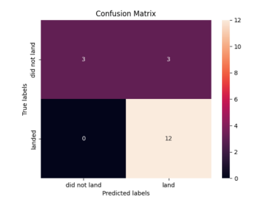
Confusion Matrix
12 True Positive
3 True Negative
3 False positive
0 False Negative
Precision: 12/15
Recall = 12/12

Slide 44
Conclusions
Models are similarly, but Decision Tree is better.
Launch Sites increases over time
Orbits like ES L1, GEO, HEO have a 100% success rate
When Payload Mass increases the success rate increases too.
Is recommendable has a dataset with large records
And also is recommendable try with another classification models

Slide 45


